Slide 1

RASPBERRY PI
DAGUENET Clément

Slide 2
SUMMARY
- Characteristics
- Current consumption
- Specifications
- SenseHat
- Programming exemple

Slide 3
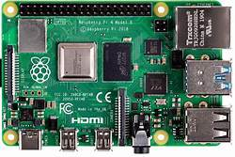
CHARACTERISTICS
- Nano computer
- Linux environment
- Multiple functions

Slide 4
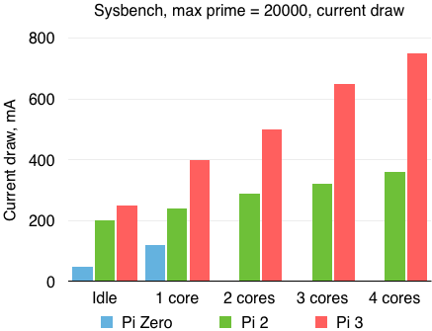
CURRENT CONSUMPTION

Slide 5
SPECIFICATIONS
SoC: Broadcom BCM2837B0 quad-core A53 (ARMv8) 64 bits 1.4GHz
GPU: Broadcom Videocore-IV
RAM: 1GB LPDDR2 SDRAM
Networking: Gigabit Ethernet, 2.4GHz and 5GHz 802.11b/g/n/ac Wi-Fi
Bluetooth: 4.2, Bluetooth Low Energy (BLE)
Storage: Micro-SD
GPIO: 40-pin GPIO header, populated
Ports: HDMI, 3.5mm audio-video jack, 4x USB 2.0, Ethernet, CSI, DSI
Dimensions: 82mm x 56mm x 19.5mm, 50g

Slide 6
SENSE HAT
Gyroscope : Angular rate sensor (dps): ~245/500/2000
Accelerometer : Linear acceleration sensor (g): ~2/4/8/16
Magnetometer : Magnetic sensor (gauss): ~4/8/12/16
Barometer : 260 - 1260 hPa absolute range (accuracy depends on the temperature and pressure, ~0.1 hPa under normal conditions)
Temperature sensor : Accurate to ~2°C in the 0-65°C range
Relative humidity sensor : Accurate to ~4.5% in the 20-80%rH range, accurate to ~0.5°C in 15-40°C range

Slide 7
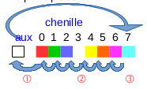
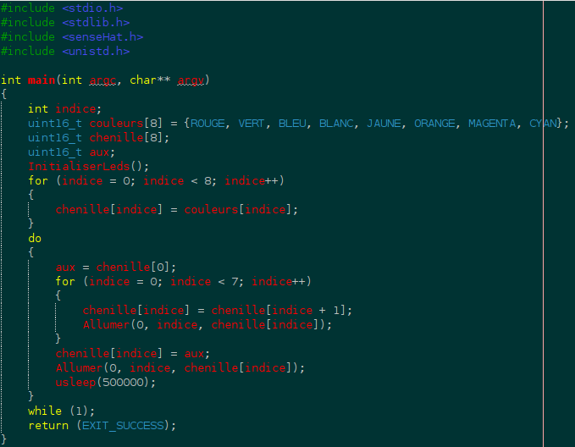
PROGRAMMING EXEMPLE

